Slide 1


Migrating to a Modern Web Application

Slide 2


Welcome to Panaya
A SaaS company
Leading the area of impact and risk analysis to ERP systems
Integrating with Salesforce, ServiceNow, SAP, Oracle ERP
Agile workflow tool for IT And development teams
We’re hiring!

Slide 3
Hi ☺
Uri Shmueli (ushmueli@panaya.com)
Full Stack Team Lead
Love Front-End
Back-End is also fine

Slide 4

Our Story Begins…
Running AngularJS 1.4
ECMAScript 5
No bundler (i.e. Webpack)
No package management (i.e. NPM)

Slide 5
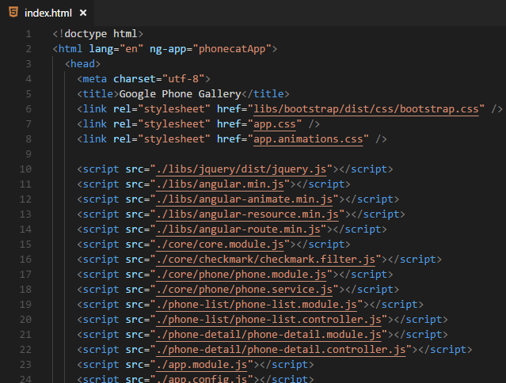
Our Starting Point

Slide 6

Lets upgrade

Slide 7
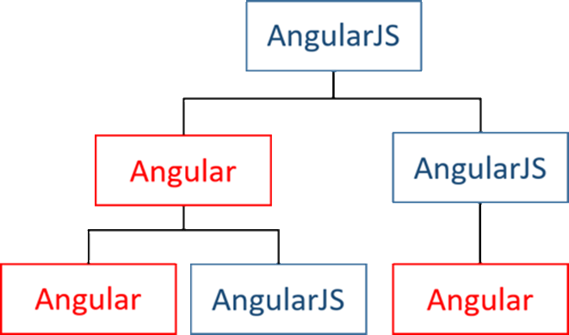
After several months…

Slide 8

Hybrid Application at Run-time
Angular
AngularJS

Slide 9

Until one day…

Slide 10
The Show Stopper – digest in progress
core.es5.js?de3d:1020 ERROR Error: [$rootScope:inprog] http://errors.angularjs.org/1.4.3/$rootScope/inprog?p0=%24digest
at angular.js:38
at r (angular.js:16200)
at n.$digest (angular.js:15637)
at eval (static.es5.js?fadf:1321)
at SafeSubscriber.schedulerFn [as _next] (core.es5.js?de3d:3647)
at SafeSubscriber.__tryOrUnsub (Subscriber.js?9a65:238)
at SafeSubscriber.next (Subscriber.js?9a65:185)
at Subscriber._next (Subscriber.js?9a65:125)
at Subscriber.next (Subscriber.js?9a65:89)
at EventEmitter.Subject.next (Subject.js?104a:55)

Slide 11
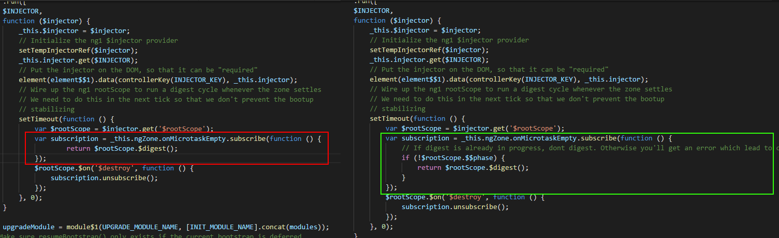
@angular/upgrade/static.es5.js

Slide 12


Slide 13




We Gained

Slide 14
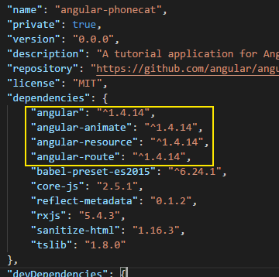
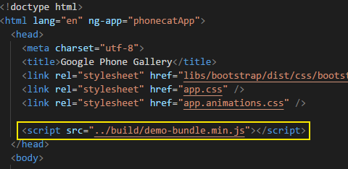
package.json
webpack.config.js
index.html

Slide 15
We Still Want To Upgrade!

Slide 16

panaya.decorators.ts

Slide 17

Introducing
ng-metadata
https://github.com/ngParty/ng-metadata
Thanks Dima Abramovich! ☺
(dabramovich@panaya.com)

Slide 18
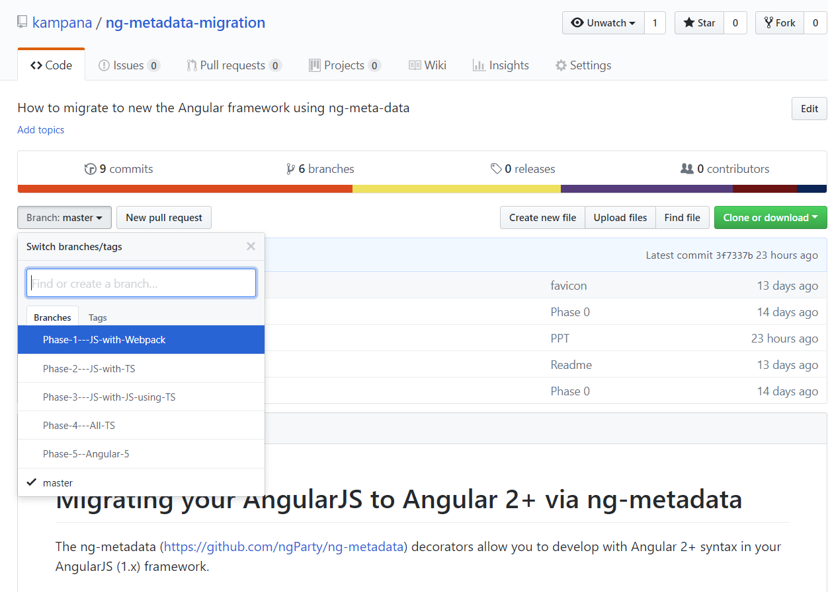
https://github.com/kampana/ng-metadata-migration/

Slide 19
What’s Next? Let’s Code!

Slide 20
To Sum Up
Upgrade alternatives
IFrame
UpgradeModule / DowngradeModule
Ng-metadata

Slide 21
Q&A

Slide 22
Thank you

